Slide 1

Solar Panels for homes
By Claudia Logrande, arica mcneal, michelle Chavez
WozU/ Southern career Institute/ Entity

Slide 2

Introduction presentation
Girl Power Team – Sun Power Team
A group of single moms, teamed up to work on this project, helping each other just like in life to better ourselves and learning from each other.
Different backgrounds with the same goals to better ourselves by learning new things and succeeding. Setting a good example for kids and point them in the right direction “You are never too old to learn new things”.

Slide 3
Claudia Logrande
Originally, I was an International student.
Involved in environmental issues starting at an early age back in Europe.
I like to Volunteer time for environmental issues and homeless shelters.
Single mom of 3 kids.
I am a Derivatives Analyst (Finance).
I have a BA in Business Administration, concentration in Finance. Started a totally different program with WOZU to learn more about Data Science.

Slide 4
Arica mcneal
Single mother of one.
My daughter is very active in dance and cheer which occupies most of my free time.
I currently work for the state of Ohio Bureau of Workers' Compensation as a Claims Service Specialist where I manage worker's compensation claims.
I started this Data Science program because I wanted to learn more about it and felt I needed a change.

Slide 5
Michelle chavez
My name is Michelle Chavez.
I’m a single mother of four.
I am working for UPS as an On-road supervisor. I have worked for them for 4 years doing various jobs.
I started this course to expand my skill set.

Slide 6
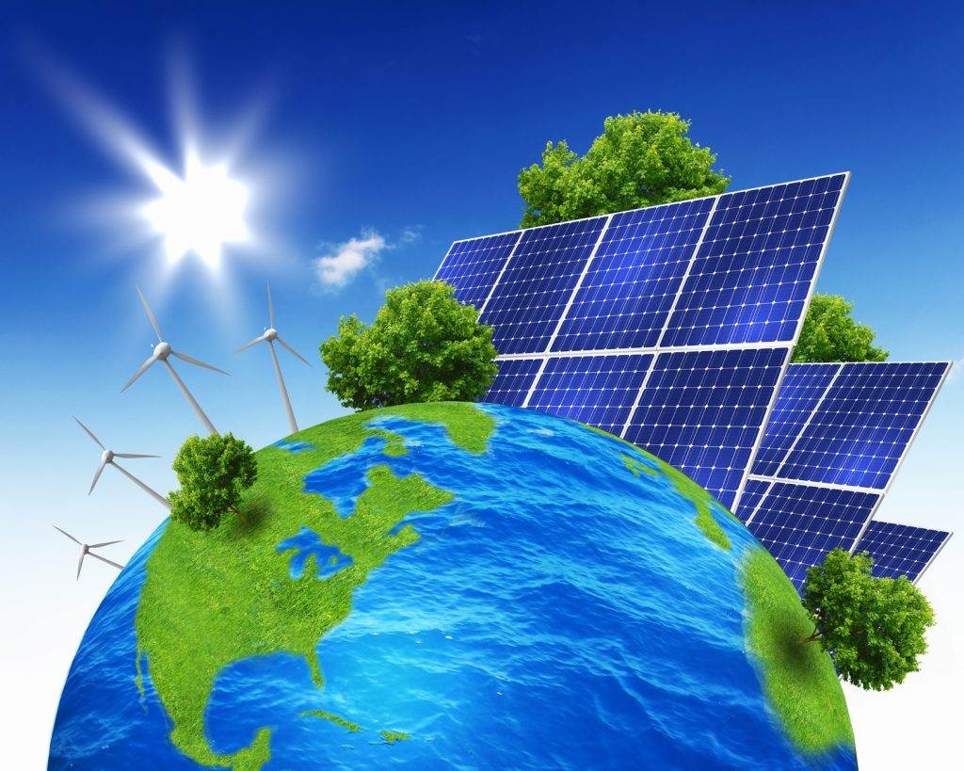
Why Solar panels from home
Energy costs have been rising every year, the story began when looking for ways to save money in the long run using solar panels for homes.
Another reason to research this subject is because it’s an efficient and greener way to use the natural power of the sun to power all household’s electrical needs.
This Photo by Unknown Author is licensed under CC BY

Slide 7
Wrangling with python
Finding datasets
Creating a new dataset based on government data available on the internet
Started using 4 states based on our location, then added all 50 states to the dataset
Merging the different dataset
Wrangling using different plots and statistical elements with Python
https://d.docs.live.net/d651ccd468905d1c/Documents/1FinalP/SolarW4New.ipynb
* Solar Power Data for Integration Studies | Grid Modernization | NREL

Slide 8
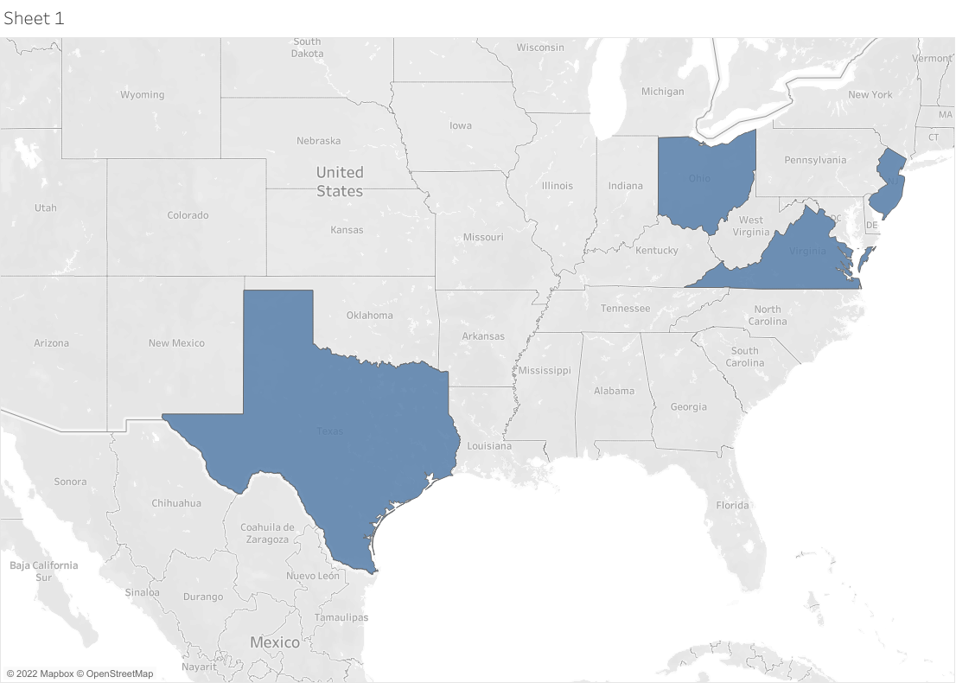
first tableau wrangling idea
Originally, we were using only four states, as we were
interested to find out more about the states we live in,
then the data was not enough to get our standard
deviation data and other Basic Anova variables so
we decided to add of all the 50 states.
This is the original Tableau visualization used with the 4 States
https://d.docs.live.net/d651ccd468905d1c/Documents/1FinalP/FinalP2.twbx
*State-By-State Map | SEIA

Slide 9
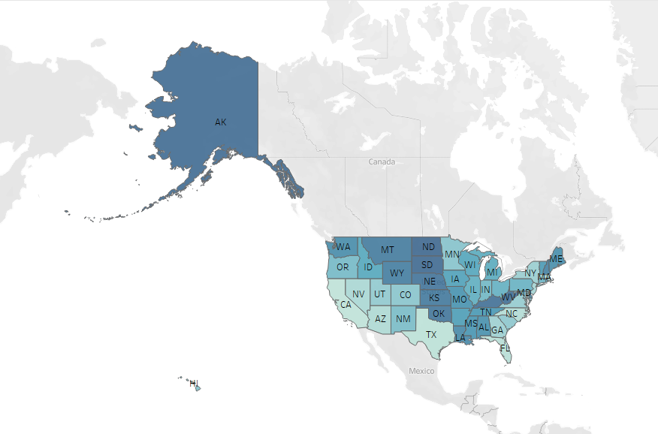
Final tableau version-All the states
This is the final Tableau view, including all the states
https://d.docs.live.net/d651ccd468905d1c/Documents/1FinalP/all%20states_Solar.twbx
*State-By-State Map | SEIA

Slide 10
SURVEY
Another method used for this project is survey of a population sample.
Qualitative/Convenient way survey- asking questions to friends and neighbors that already have solar power in their houses.
“Great choice!”, “Got $2,700 back from selling my solar power back in June”- by Amanda
“Be careful on choosing a good solar power company, as ours was small and went out of business”- By Ranieh
“You will not regret it”- By James
Results from the survey was very positive in all
*Population sample taken in the state of New Jersey January 2021.

Slide 11
What are the pros of solar power energy?
Environmentally friendly
Solar energy saves money long term
Easy to use
Money back from State
Money back for selling the power that is not used, to other energy companies (through the grid).
*www.Forbes.com/advisor/home-improvement/solar-energy-pros-and-cons/

Slide 12
What are the Cons of solar power energy?
Upfront costs to buy or lease solar panels
Production relies on sunlight
There are not currently methods to recycle old solar panels
Production of solar panels can be harmful to environment
*www.Forbes.com/advisor/home-improvement/solar-energy-pros-and-cons/

Slide 13
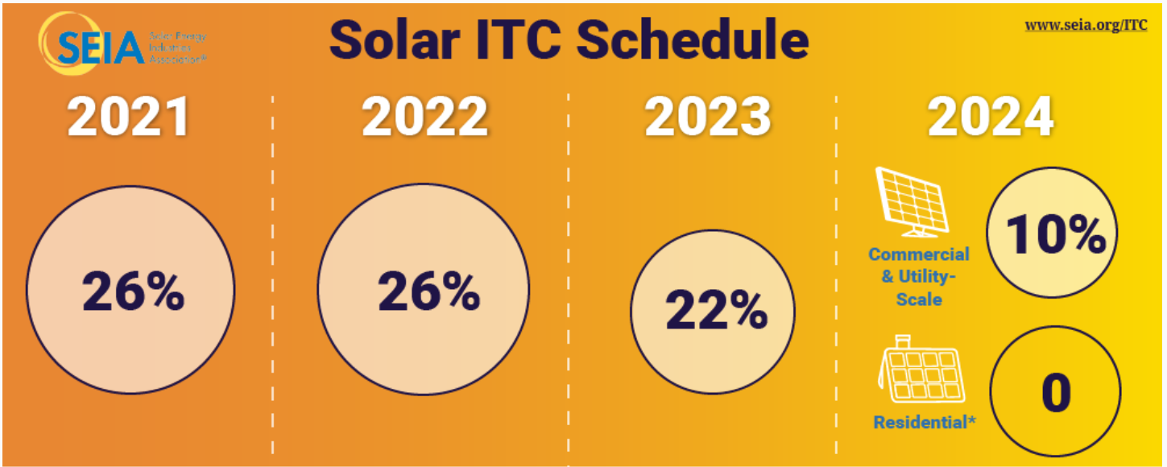
Solar investment tax credit
One important federal tax credit is called ITC, Investment Tax Credit.
ITC is 26%.
ITC is the same tax credit in all the United States of America.
Projection of ITC is expected to decrease in 2023, as the solar panels are also expected to decrease.
*Solar Investment Tax Credit (ITC) | SEIA

Slide 14
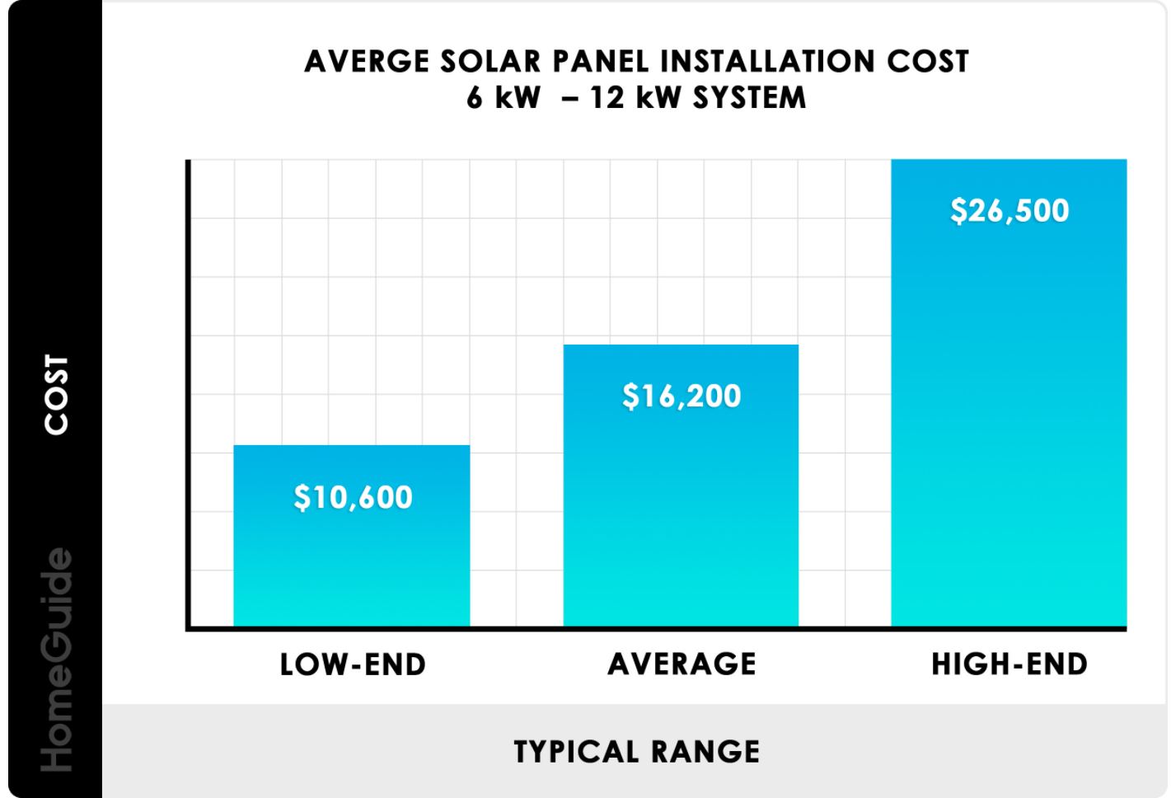
Solar power costs
Solar power installation costs varies depending on the solar company and the type of panels chosen.
Most panels last around 50 years but have 25 years warranty
*2022 Solar Panel Costs | Average Installation Cost Calculator (homeguide.com)

Slide 15
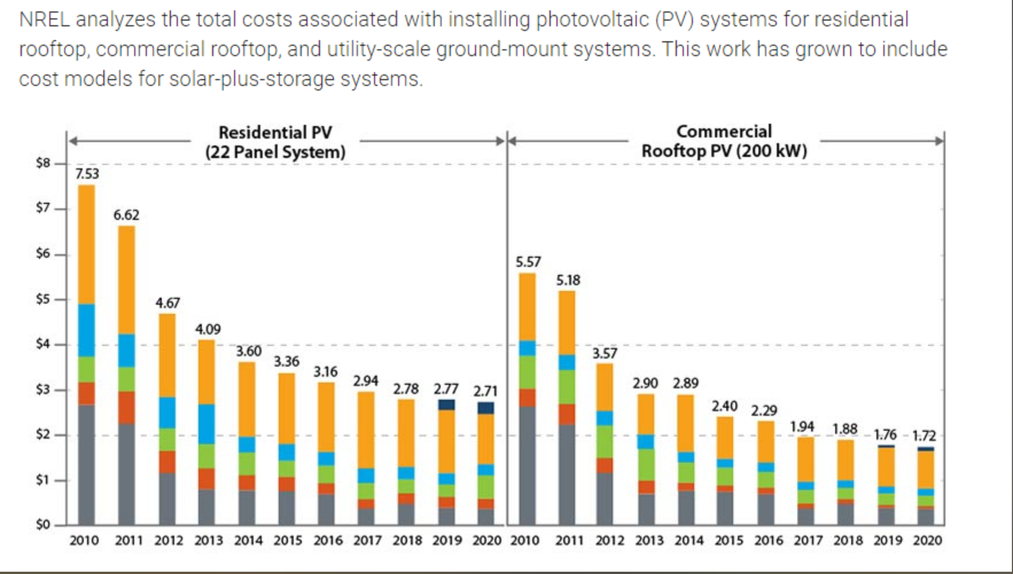
Cost of solar panels over time
The cost of solar panels is projected to decrease over time, based on the government research.
*Solar Power Data for Integration Studies | Grid Modernization | NREL

Slide 16
Solar panel summary review
Solar panels for home are a great resource to use toward a greener planet.
Federal taxes are helping homeowners getting money toward the purchase of the solar panels.
The increasing energy costs are pushing toward finding new ways to power the population household needs.
Selling the solar power energy, generated by the solar power, is a great way to make some extra money.

Slide 17
Project event summary
Researching for datasets for our project was challenging
Creating our own datasets was exciting
Wrangling for ideas was a great way to put everything we learned into a different prospective
Creating tableau was fun and entertaining (interactive maps).
Doing the population sample survey was very useful.
The power point presentation is a great way to combine and link everything together and we had fun with it.
This is the end of our presentation; we hope you enjoyed it.
Any questions?

